Slide 1

﷽
Huroof Al-Muqatta’at

Slide 2

Al-Muqatta’at
What Are Ḥurūf al-Muqattaʿāt?
The word Ḥurūf means “letters,” and Muqattaʿāt means “cut off” or “disjointed.” So, Ḥurūf al-Muqattaʿāt refers to those special letters at the beginning of some surahs in the Quran that are recited individually—not joined like regular words.
Here are some examples:
Surah Al-Baqarah starts with الم (Alif Lām Mīm)
Surah Maryam starts with كهيعص (Kāf Hā Yā ʿAyn Ṣād)
Surah Qāf starts with ق (Qāf)

Slide 3
Al-Muqatta’at
Introduction
These letters appear at the beginning of 29 surahs in the Quran.
Of the 28 letters of the Arabic alphabet, exactly one half appear as muqatta'at, either singly or in combinations of two, three, four or five letters.

Slide 4
Why & what is the meaning of Haroof
There are different types of thinking regarding these Haroof. Some researchers try to find their meaning by adding different numbers.
But the best thought among all is that the Prophet (SAW) never interpreted these letters.
So, it is good to remain quiet regarding their meanings.
If the Prophet (SAW) never talked about it, we don't have to either.

Slide 5
Why & what is the meaning of Haroof
Do not join them into words. Instead, pronounce each letter separately, just like the Arabic alphabet—but using Tajweed.
Example:
الم
Alif → Just “Alif” (no stretch, very quick)
Lām → Pronounced as “Lāām” with Madd
Mīm → “Mīīm” with Madd

Slide 6
Different Huroof Al-Muqatta’at
Mystery Letters
Disjointed Letters
Separate Letters
Opening Letters
Quranic Initials
Abbreviated Letters
Huroof Al-Muqatta’at(Arabics)

Slide 7
Groups of Huroof Al-Muqatta’at
Single letter
صٓ
قۤ
نۤ
Two Letter
طٰهٓ
يٰسٓ
حٰمٓ
طٓسٓ
three letter
الٓمٓ
الٓر
طٓسٓمٓ
طٓسٓ
Four letter
الٓمٓصٓ
الٓمٓر
Five letter
كٓهٰيٰعٓصٓ
حٰمٓعٓسٓقٓ

Slide 8

الۤمّۤ
م
میم
ل
لام
ا
الف

Slide 9
الۤمّۤصۤ
ص
صاد
م
میم
ل
لام
ا
الف

Slide 10
الۤرٰ
ر
را
ل
لام
ا
الف

Slide 11
الٓمّٓر
ر
را
م
میم
ل
لام
ا
الف

Slide 12
کۤھٰیٰعۤصۤ
ص
صاد
ع
عین
ي
یا
ك
کاف
ھ
ھا

Slide 13
طٰہٰ
ہ
ھا
ط
طا

Slide 14
طٰسٓمّٓ
م
میم
س
سین
ط
طا

Slide 15
س
سین
ط
طا
طٰسۤ

Slide 16
یٰسٓ
س
سین
ي
يا

Slide 17
صٓ
ص
صاد

Slide 18
م
میم
حٰمٓ
ح
حا

Slide 19
حٰمٓ عٓسٓقٓ
ق
کاۤف
س
سین
ح
حا
ع
عین
م
میم

Slide 20
قٓ
ق
کاۤف

Slide 21
ن
نون
نٓ

Slide 22
Lets Recall
الٓمٓصٓ
صٓ
قۤ
نۤ
طٰهٓ
يٰسٓ
حٰمٓ
طٓسٓ
الٓمٓ
الٓر
طٓسٓمٓ
طٓسٓ
الٓمٓر
كٓهٰيٰعٓصٓ
حٰمٓعٓسٓقٓ

Slide 23
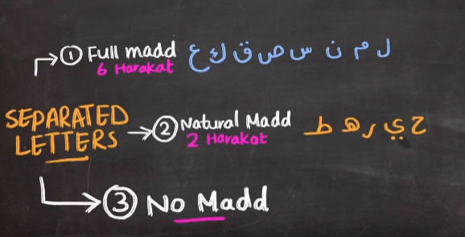
Lets Recall
الٓمٓصٓ
صٓ
قۤ
نۤ
طٰهٓ
يٰسٓ
حٰمٓ
طٓسٓ
الٓمٓ
الٓر
طٓسٓمٓ
طٓسٓ
الٓمٓر
كٓهٰيٰعٓصٓ
حٰمٓعٓسٓقٓ

