Slide 1

﷽
Quran With
Ali

Slide 2
﷽
Surah Ash-Shams, 91:3

Slide 3

وَالنَّهَارِ إِذَا جَلَّىٰهَا

Slide 4
إِذَا
وَالنَّهَارِ إِذَا جَلَّىٰهَا
جَلَّىٰهَا
وَالنَّهَارِ

Slide 5

Usually Pronounced
ل
Silent here
Waw with Fatha
ا
وَ
وَالنَّهَارِ

Slide 6
ل
ا
وَ
Assimilated into Noon due to Shamsiyyah rule.
وَالنَّهَارِ

Slide 7
Shamsiyyah Rule
Laam As-Shamsiyyah: It is written but not pronounced, and after it a Shaddah will appear.
النَّ
وَالنَّهَارِ

Slide 8
1. By joining with Previews letter
2. By it’s self.
Noon with Fatha
نَ
وَالنَّهَارِ

Slide 9
Silent elongation letter
هَ
ا
Ra with Kasra
رِ
وَالنَّهَارِ
Pronounced Lightly

Slide 10
Silent elongation letter.
Dhal with Fatha
Hamza with Kasra
ا
ذَ
إِ
إِذَا

Slide 11
Silent Elongation
Hah With Fatha
Waw with Fatha
ا
هَ
جَ
Madd Asli
2 - Harakat
جَلَّىٰهَا

Slide 12
وَالنَّهَارِ إِذَا جَلَّىٰهَا

Slide 13
وَالنَّهَارِ إِذَا جَلَّىٰهَا

Slide 14
وَالنَّهَارِ إِذَا جَلَّىٰهَا

Slide 15
وَالنَّهَارِ إِذَا جَلَّىٰهَا

Slide 16
Any Question
Instagram : @learningquranwithali
Email: muhammadaliraza281@gmail.com
Email: quranwithali281@gmail.com

Slide 17
Assimilated into Noon Due to Shamsiyyah Rule
Silent here
Waw with Fatha
النَّ (ا + ل + نّ)
ا
وَ
جَلَّىٰهَا
Notes:
ل (Lam) is usually pronounced, but in this case, it is assimilated into Noon due to Shamsiyyah rule

Slide 18
لاَم الشَّمْسِيَّة
لاَم الْقَمَرِيَّة
Laam As-Shamsiyyah
Laam Al-Qamariyyah
he Laam is not pronounced
The Laam is pronounced
Laam Al-Qamariyyah: It is written and pronounced, and after it a Shaddah does not appear.
The rule: It will be recited with Ith’har if after the Laam comes any of the Huroof Al-Qamariyyah (Moon Letters).
The Moon letters are:
ا, ب, غ , ح , ج , ك , و , خ , ف , ع , ق , ي , م , ه
Notes:
ل (Lam) is usually pronounced, but in this case, it is assimilated into Noon due to Shamsiyyah rule

Slide 19
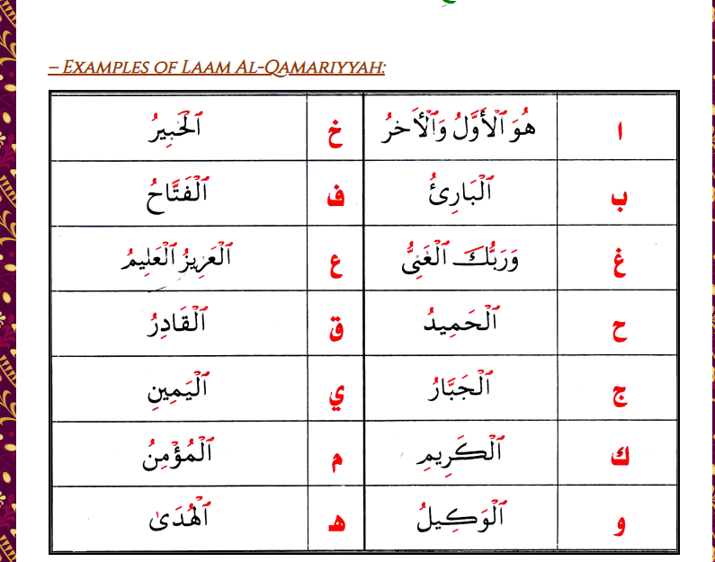
لاَم الشَّمْسِيَّة
لاَم الْقَمَرِيَّة
Laam As-Shamsiyyah
Laam Al-Qamariyyah
he Laam is not pronounced
The Laam is pronounced
Laam Al-Qamariyyah: It is written and pronounced, and after it a Shaddah does not appear.
The rule: It will be recited with Ith’har if after the Laam comes any of the Huroof Al-Qamariyyah (Moon Letters).
The Moon letters are:
ا, ب, غ , ح , ج , ك , و , خ , ف , ع , ق , ي , م , ه
Notes:
ل (Lam) is usually pronounced, but in this case, it is assimilated into Noon due to Shamsiyyah rule

Slide 20
لاَم الشَّمْسِيَّة
لاَم الْقَمَرِيَّة
Laam As-Shamsiyyah
Laam Al-Qamariyyah
he Laam is not pronounced
The Laam is pronounced
Laam As-Shamsiyyah: It is written but not pronounced, and after it a Shaddah will appear.
It will be read with Idghaam without Ghunna if after the Laam comes any of the Huroof As-Shamsiyyah (Sun Letters)
The Moon letters are:Other the Moon latters
Notes:
ل (Lam) is usually pronounced, but in this case, it is assimilated into Noon due to Shamsiyyah rule
https://attajweed4beginners.wordpress.com/the-rules-of-laam-al-qamariyyah-and-laam-as-shamsiyyah/

Slide 21
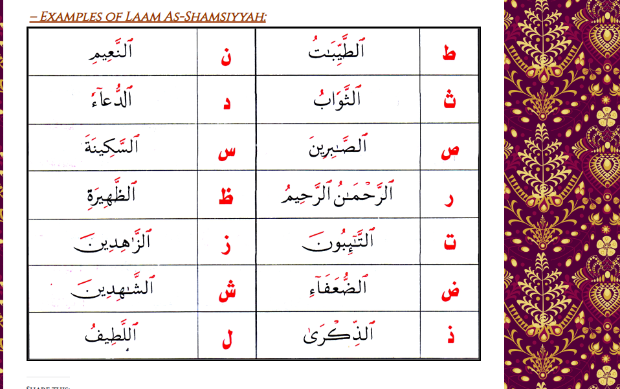
لاَم الشَّمْسِيَّة
لاَم الْقَمَرِيَّة
Laam As-Shamsiyyah
Laam Al-Qamariyyah
he Laam is not pronounced
The Laam is pronounced
Laam As-Shamsiyyah: It is written but not pronounced, and after it a Shaddah will appear.
It will be read with Idghaam without Ghunna if after the Laam comes any of the Huroof As-Shamsiyyah (Sun Letters)
The Moon letters are:Other the Moon latters
Notes:
ل (Lam) is usually pronounced, but in this case, it is assimilated into Noon due to Shamsiyyah rule
https://attajweed4beginners.wordpress.com/the-rules-of-laam-al-qamariyyah-and-laam-as-shamsiyyah/

Slide 22
Waw with Fatha
و
Silent here
ا
وَالنَّهَارِ

Slide 23
Waw with Fatha
و
Silent here
ا
وَالنَّهَارِ
What is Qalqala?

Slide 24
What is Qalqala?
Qalqala (قَلْقَلَة) means a "bouncing" or "echoing" sound that occurs when a Sakin letter (a letter with Sukoon or at the end of a stop) belongs to the Qalqala letters:
Qalqala Letters: ق ط ب ج د (Gathered in the phrase: قطب جد)
🔹 Qalqala happens when:
One of these five letters (ق ط ب ج د) has Sukoon.
The letter is at the end of a verse or a stop in recitation.

Slide 25
نّ
Shaddah (Doubling of the letter)
وَٱلنَّهَارِ إِذَا جَلَّىٰهَا

Slide 26
First Time
وَٱلنَّهَارِ إِذَا جَلَّىٰهَا

Slide 27
وَٱلنَّهَارِ إِذَا جَلَّىٰهَا

Slide 28
وَٱلنَّهَارِ إِذَا جَلَّىٰهَا

Slide 29
وَٱلنَّهَارِ إِذَا جَلَّىٰهَا

Slide 30
وَٱلنَّهَارِ إِذَا جَلَّىٰهَا

Slide 31
وَٱلنَّهَارِ إِذَا جَلَّىٰهَا

Slide 32
وَٱلنَّهَارِ إِذَا جَلَّىٰهَا

Slide 33
Shaddah (Doubling of the letter)
وَٱلنَّهَارِ إِذَا جَلَّىٰهَا
جَّ

Slide 34
وَٱلنَّهَارِ إِذَا جَلَّىٰهَا

Slide 35
وَٱلنَّهَارِ إِذَا جَلَّىٰهَا

Slide 36
وَٱلنَّهَارِ إِذَا جَلَّىٰهَا

Slide 37
وَٱلنَّهَارِ إِذَا جَلَّىٰهَا

Slide 38
وَٱلنَّهَارِ إِذَا جَلَّىٰهَا
ح
Middle of the throat
ھ
Bottom of the throat

Slide 39
وَٱلنَّهَارِ إِذَا جَلَّىٰهَا

